Slide 1
Cyclistic Case Study
by William Guiñansaca

Slide 2
About the company
Cyclistic is a fictional company related to a bike-share business. It wants to improve its profit by becoming the most of its clients in annual memberships.
The company works with these pricing plans: single-ride passes, full-day passes, and annual memberships. Customers who purchase single-ride or full-day passes are referred to as casual riders. Customers who purchase annual memberships are Cyclistic members.

Slide 3
Project objective:
Cyclistic’s finance analysts have concluded that annual members are much more profitable than casual riders. Then, the goal is to design marketing strategies aimed at converting casual riders into annual members.

Slide 4
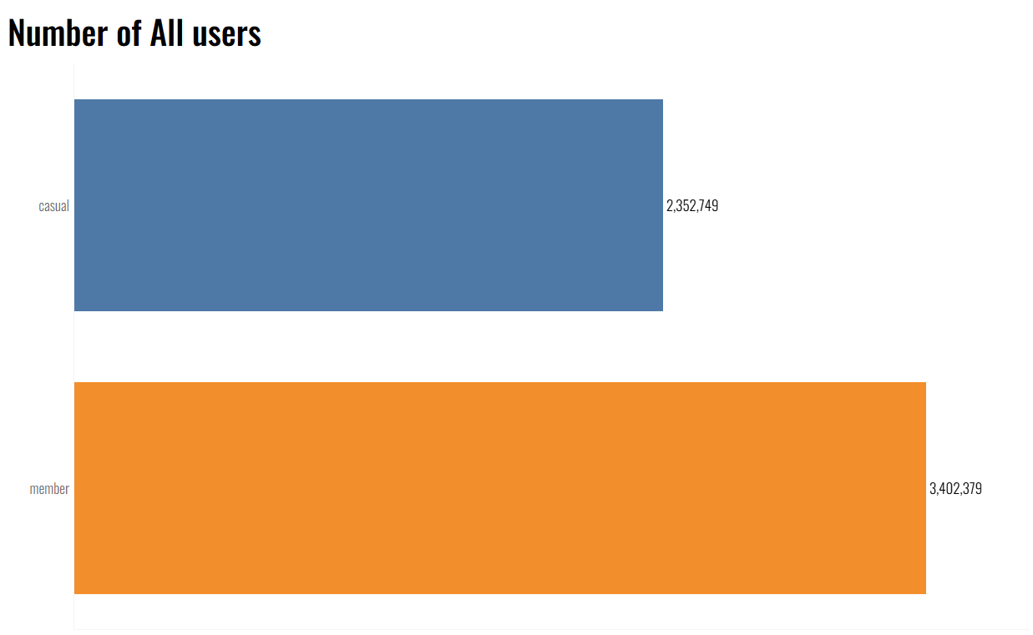
There are fewer casual users than subscribed members.

Slide 5
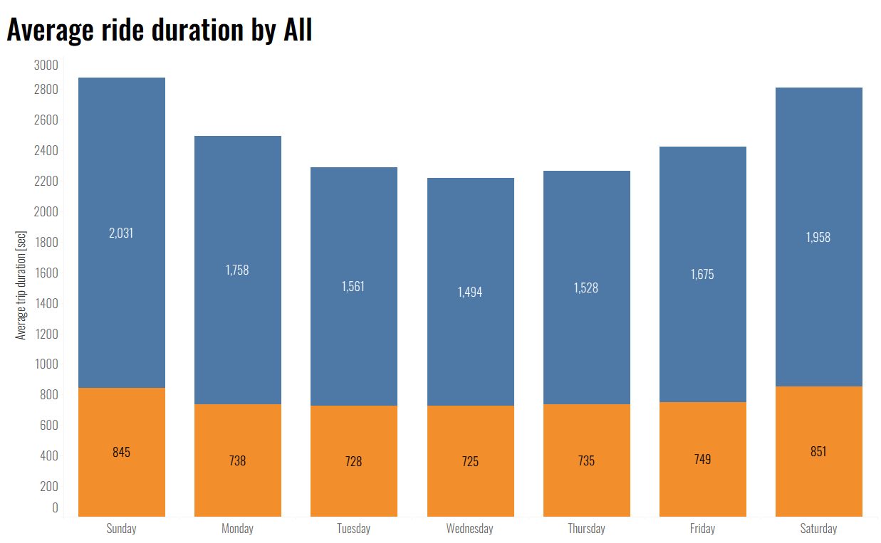

The rent by member users keep its behavior during the workweek. In both cases, there are more longer trips during the weekend.

Slide 6
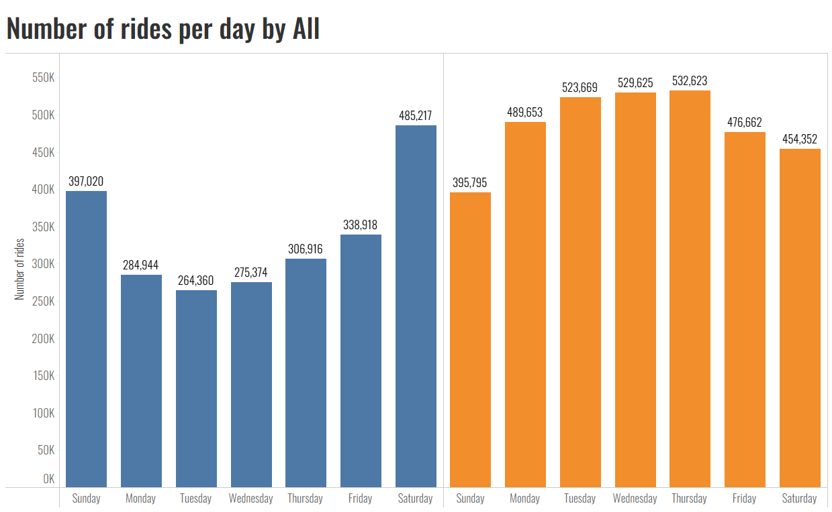
The workweek favors member users, and it is important to note that during the weekend, casual users outnumber member users. We can observe that there is significant bicycle usage by casual users during the workweek.

Slide 7
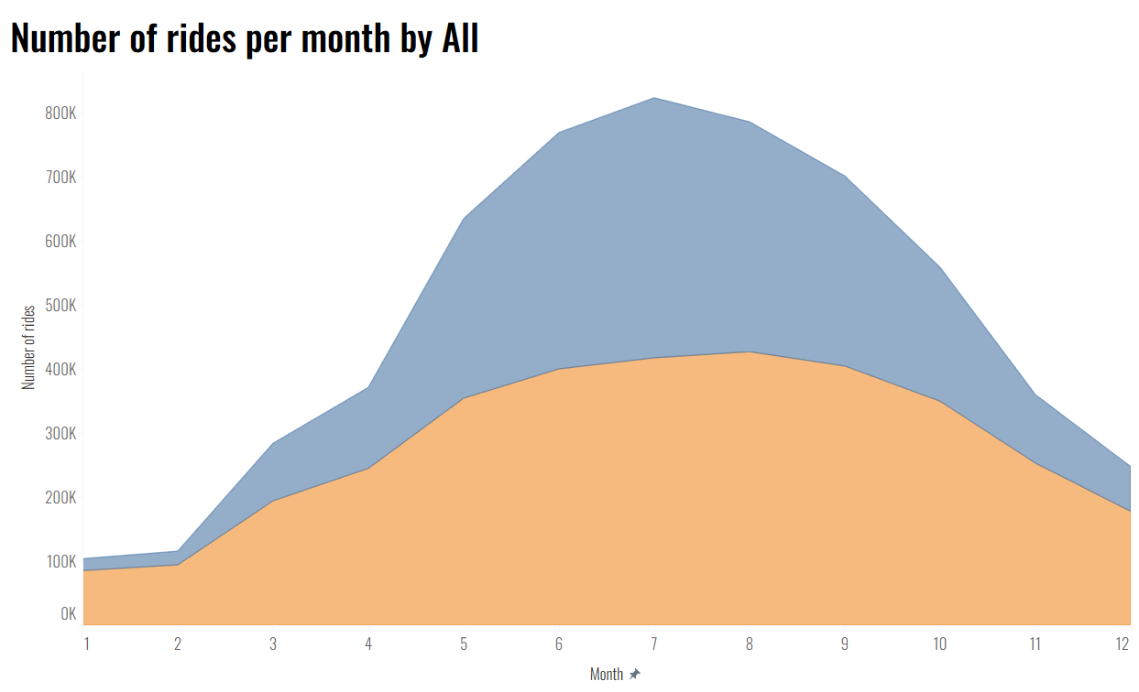
The most popular months for member users are July and August, while June and July are the most popular for casual riders.

Slide 8
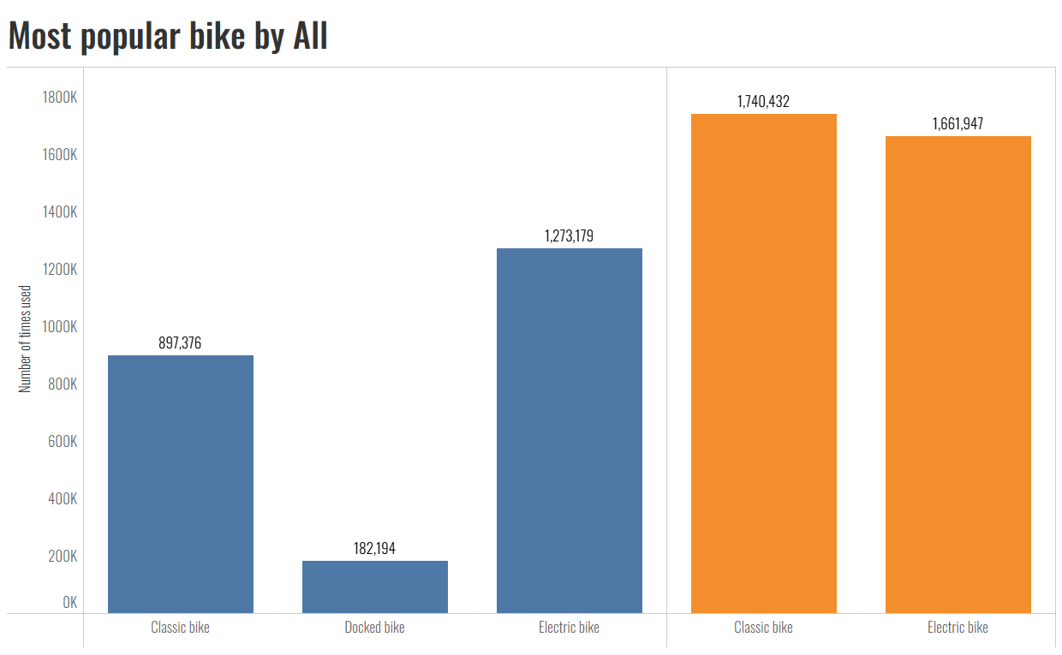
The docked bike can only be used by casual users, and the most popular bike for them is the electric bike, while classic bikes are slightly more preferred by members than electric bikes.

Slide 9
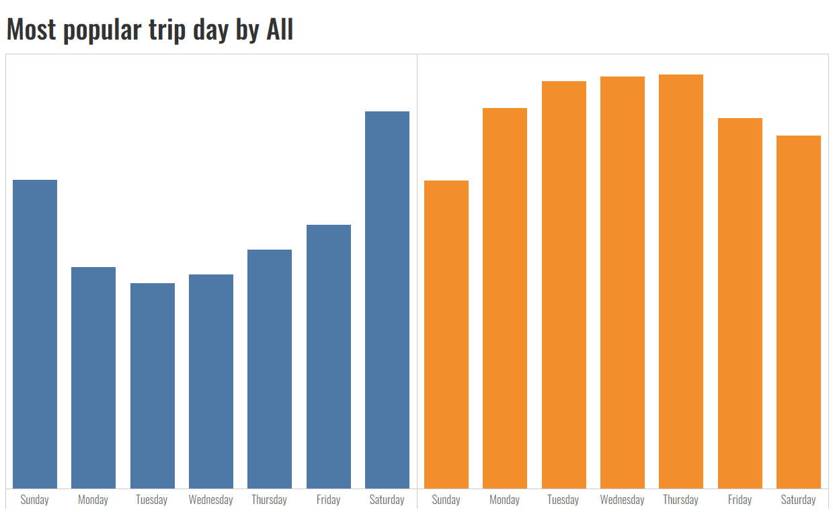
The most popular day for casual users is Saturday, while for member users it's Thursday.

Slide 10
Conclusion:
Casual members use bikes mainly on weekends, while members use bikes for a constant time during all their trips in the workweek. Additionally, while casual users spend more time on their trips, members try to save time with shorter trips averaging 12 minutes.
These facts indicate the importance of weekends, and it is noteworthy to mention the peak of the curve during summer months. Therefore, months like June, July, and August have more bike rentals than any other season.

Slide 11
Recommendations
Casual users cannot be converted to members in the same way as the latter, due to their different reasons for renting a bike. Some recommendations:
Offer an annual weekend-only membership.
Offer a summer season membership.
Offer tour packages to attract casual users during the workweek.
Apply discounts to riders who spend more than 25 minutes on the trip.
Focus on all marketing strategies during the summer.
Focus marketing strategies on electric bikes.

Slide 12



Thanks.
Contact info:

